Slide 1
Comparative Analysis of Chronic Kidney
Disease Prediction
Batch-08
App development-Data Analytics
VAMSHI REDDY 2211CS030028
DATTU RAGHUNANDHAN 2211CS030063
PAVAN TEJA 2211CS030083
GIRIVARDHAN 2211CS030089
GUIDE : MS.PRIYANKA CHAUMWAL

Slide 2
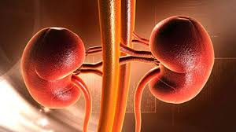
INTRODUCTION
Recent research has shown a worrying 17% increase in CKD cases worldwide, affecting 1 in 10 people. Detecting CKD early is crucial, as it allows for better treatment and control through medication. This project aims to create a simple predictive model using relevant factors to estimate the likelihood of chronic kidney disease. By doing so, we aim to identify the key factors that play a role in assessing CKD risk. The main goal is to contribute meaningfully to healthcare by using a combination of straightforward methods like logistic regression, decision tree classifier, and k-nearest neighbors. This comprehensive approach aims to address the challenge of early CKD detection, providing healthcare professionals with useful insights to intervene promptly and improve patient outcomes.Kidney Disease is cancer arising from the cervix. It Arises due to the abnormal growth of cells and spreads to other parts of the body. We can use data analytics techniques to predict if a person as cancer or not.Different factors such as smoking, Pregnancies, habits etc can be used to predict cancer.

Slide 3
OBJECTIVE OF PROJECT
The objective of the project is create model which can determine chances of the chronic kidney disease with the help of the suitable parameters.
Also, to find which are the parameters are important to check the chances of the chronic kidney disease.
This project will help for early detection of the chronic kidney disease.

Slide 4
METHODOLOGY
DATA COLLECTION
IMPORTING REQUIRED LIBRAYS
DATA LOADING
DATA PREPROCESSING
DATA VISUALIZATION
TRAIN TEST SPLIT
PREDICTION AND MODEL EVALUTION

Slide 5
Columns in our dataset
id (int64): Unique identifier for each record, age (float64): Age of the individual,bp (float64): Blood pressure,sg (float64): Specific gravity,al (float64): Albumin, su (float64): Sugar,bgr (float64): Blood glucose random,bu (float64): Blood urea,sc (float64): Serum creatininesod (float64): Sodium,pot (float64): Potassium,hemo (float64): Hemoglobin,rbc (object): Red blood cells,pc (object): Pus cell,pcc (object): Pus cell clumps,ba (object): Bacteria,pcv (object): Packed cell volume,wc (object): White blood cell count,rc (object): Red blood cell count,htn (object): Hypertension,dm (object): Diabetes mellitus,cad (object): Coronary artery disease,appet (object): Appetite,pe (object): Pedal edema,ane (object): Anemia,
classification (object): Classification (the target variable).

Slide 6
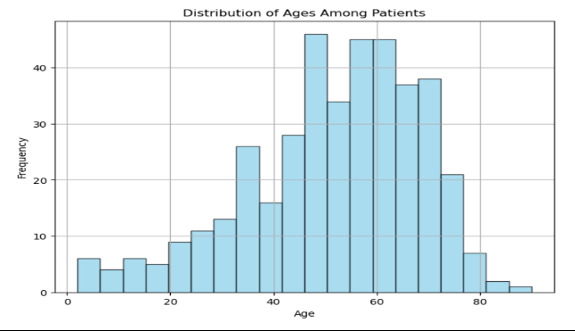
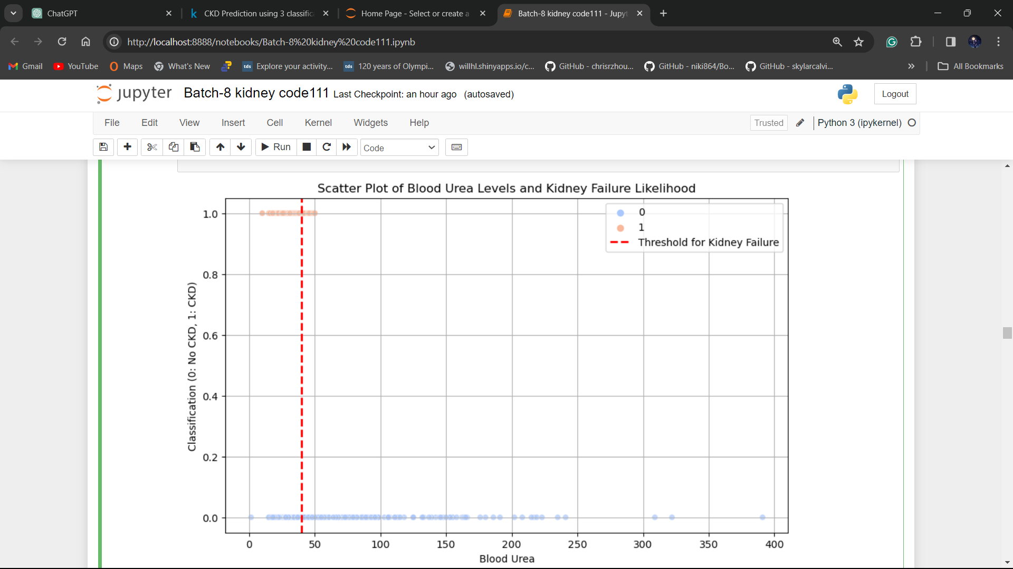
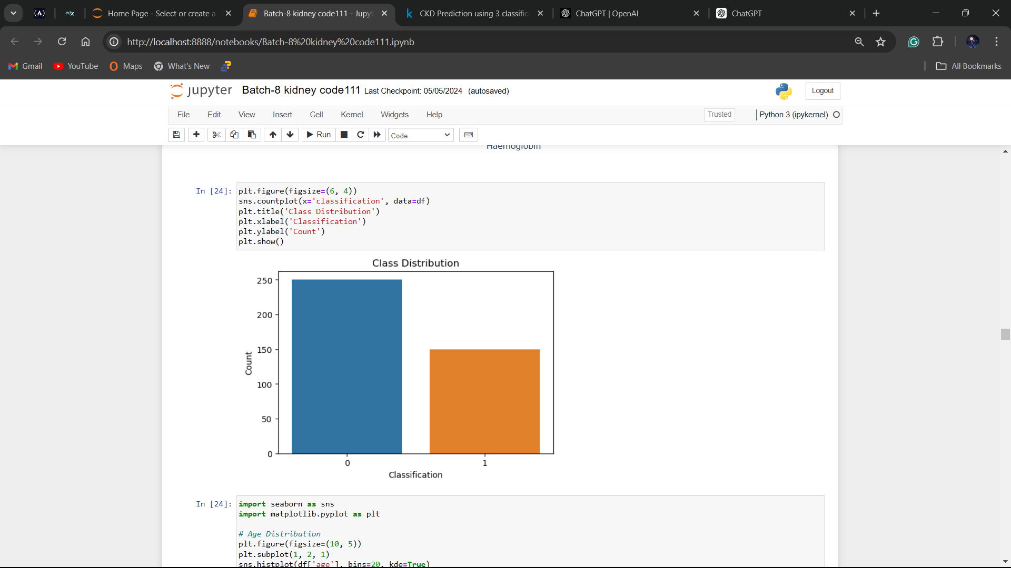
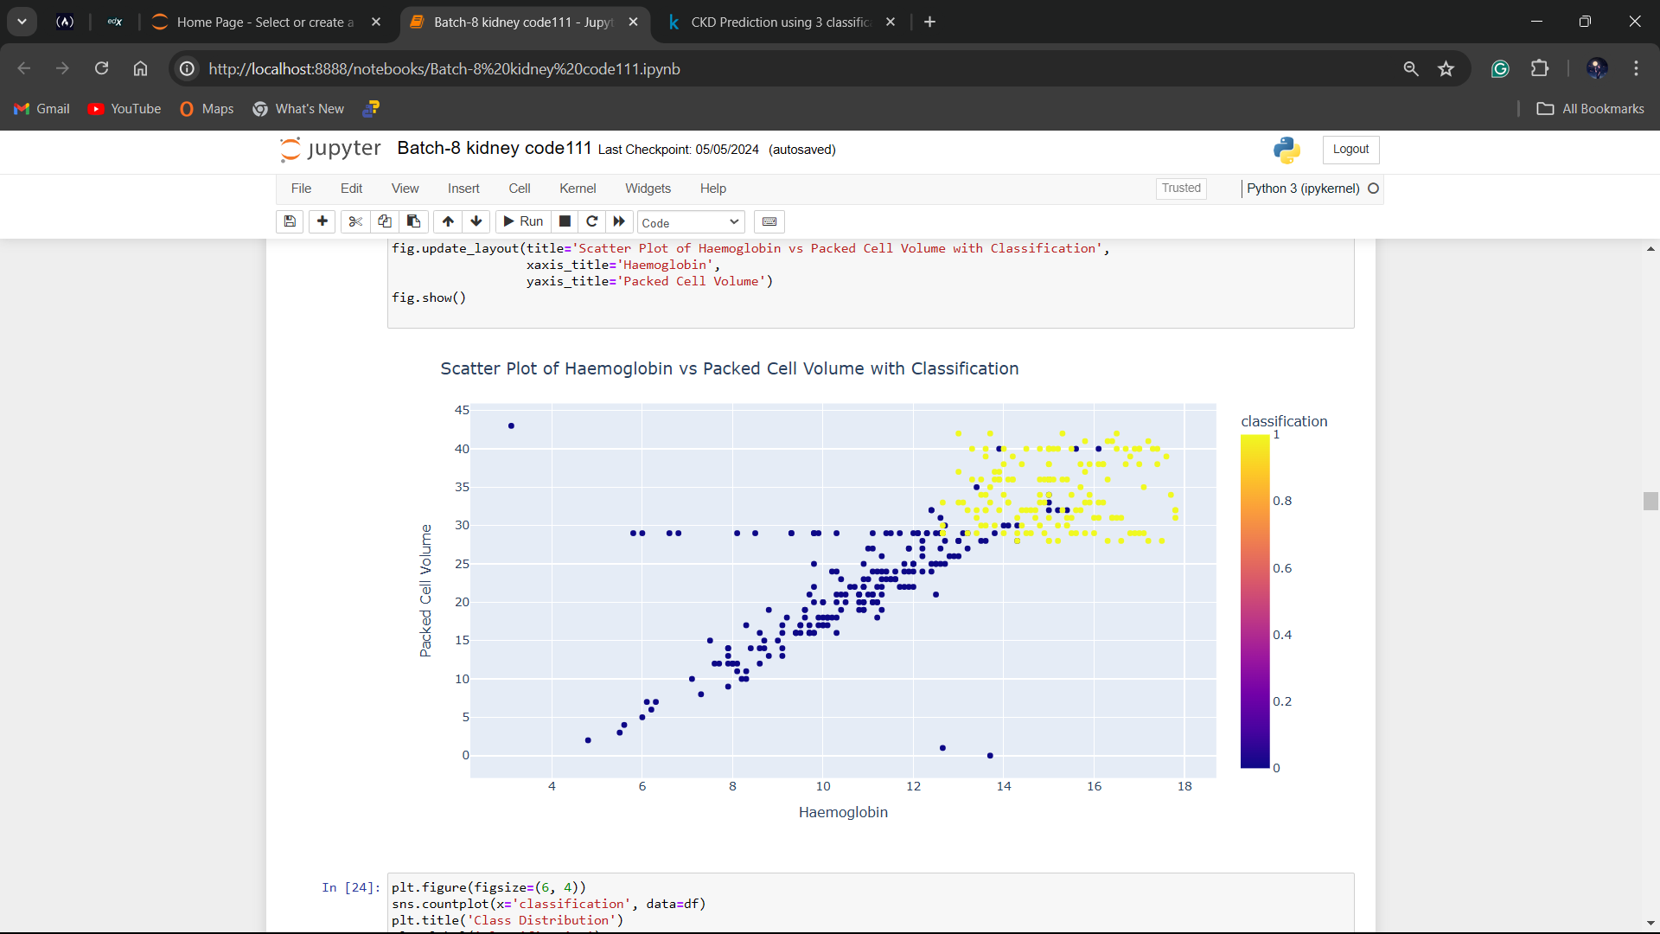
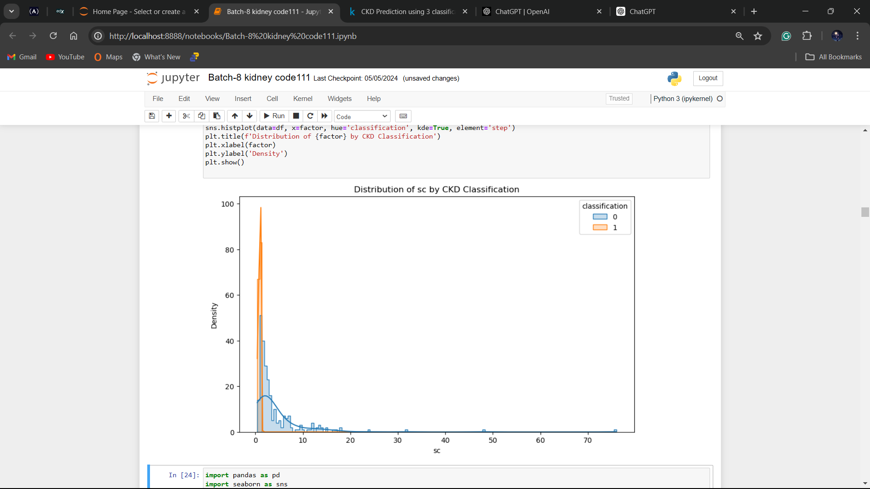
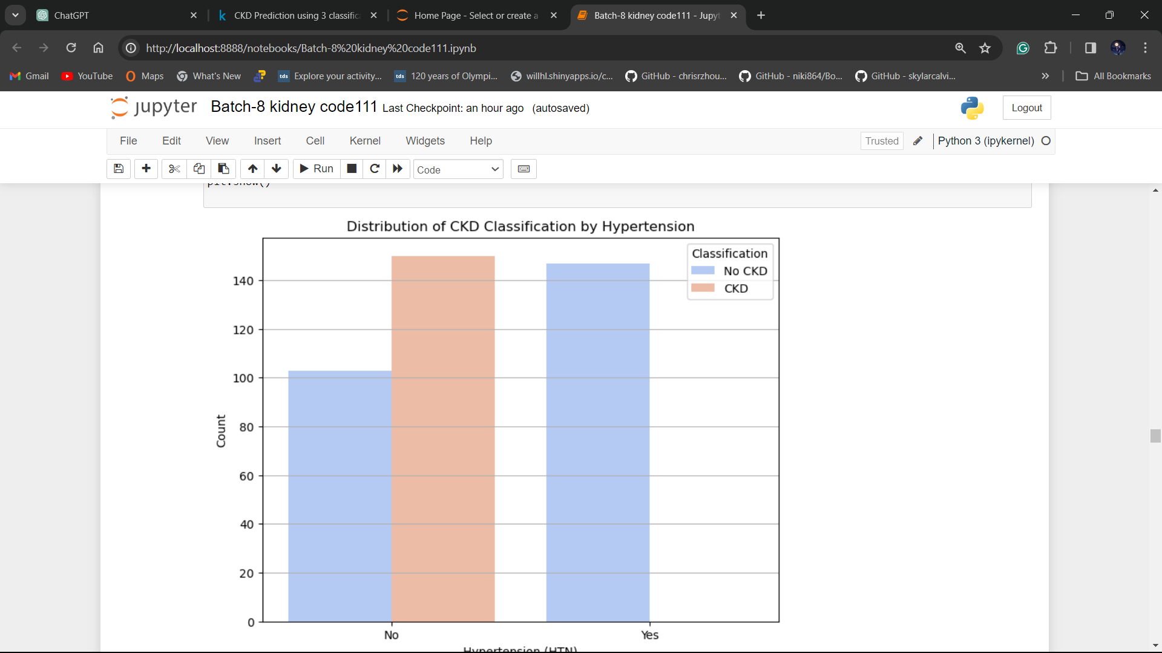
RESULTS

Slide 7
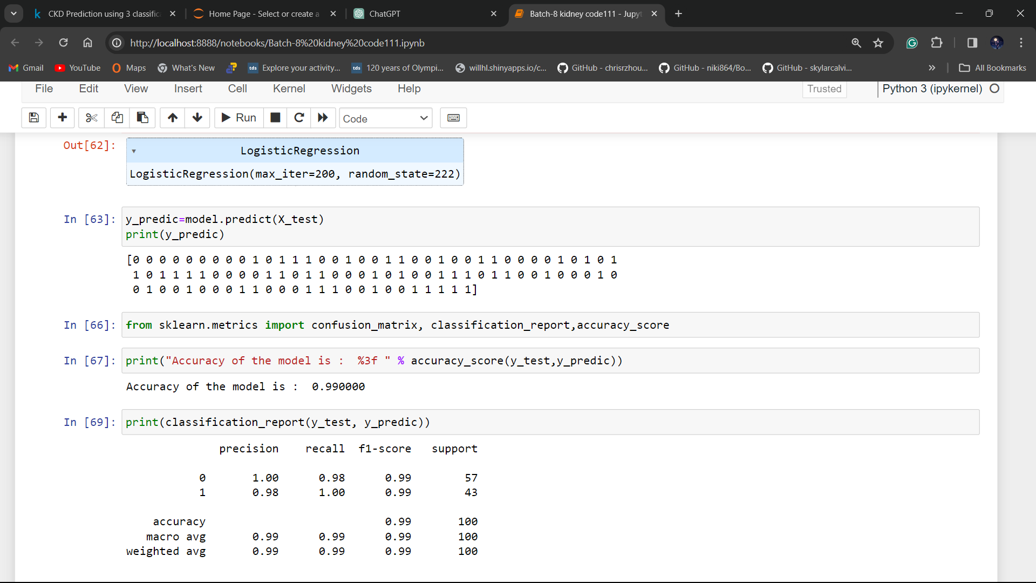
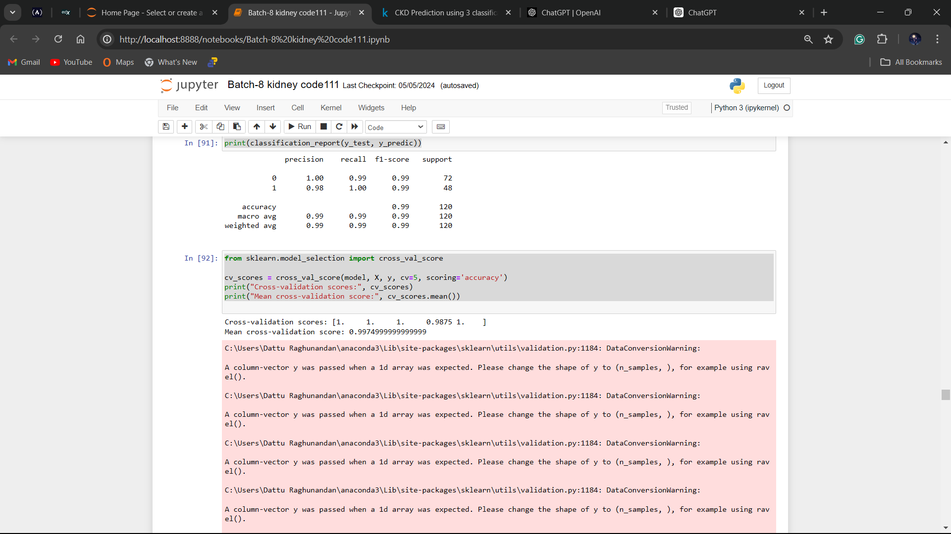
Logistic Regression Model:
Cross Validation:

Slide 8
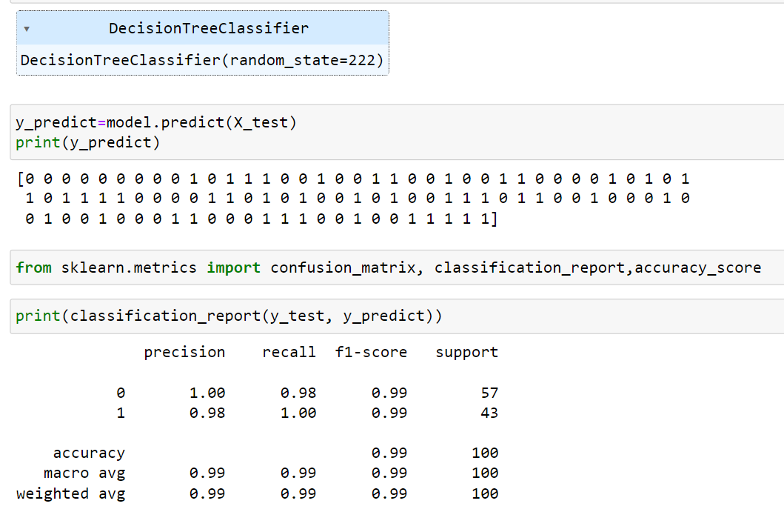
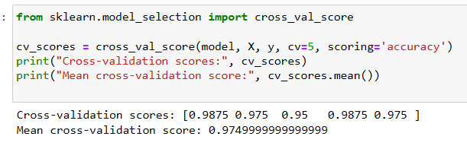
Decision Tree Classifier Model:
Cross Validation:

Slide 9
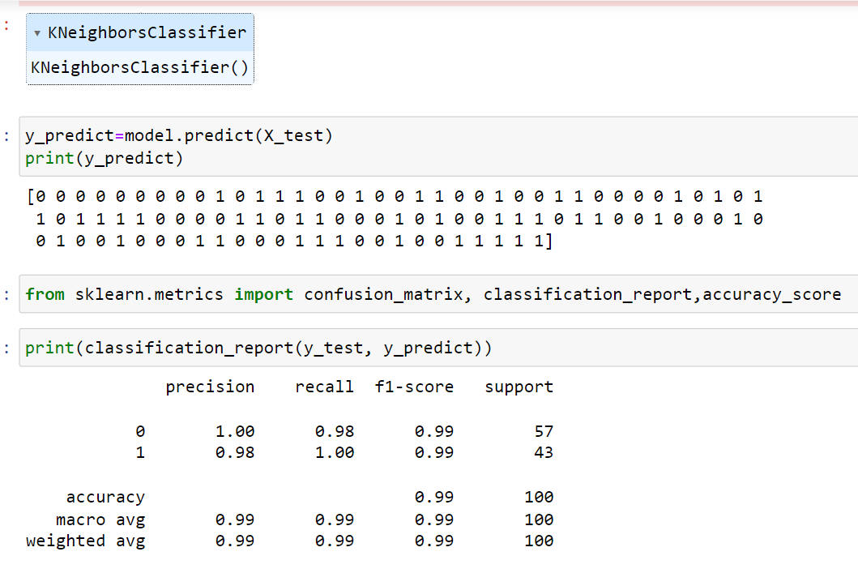
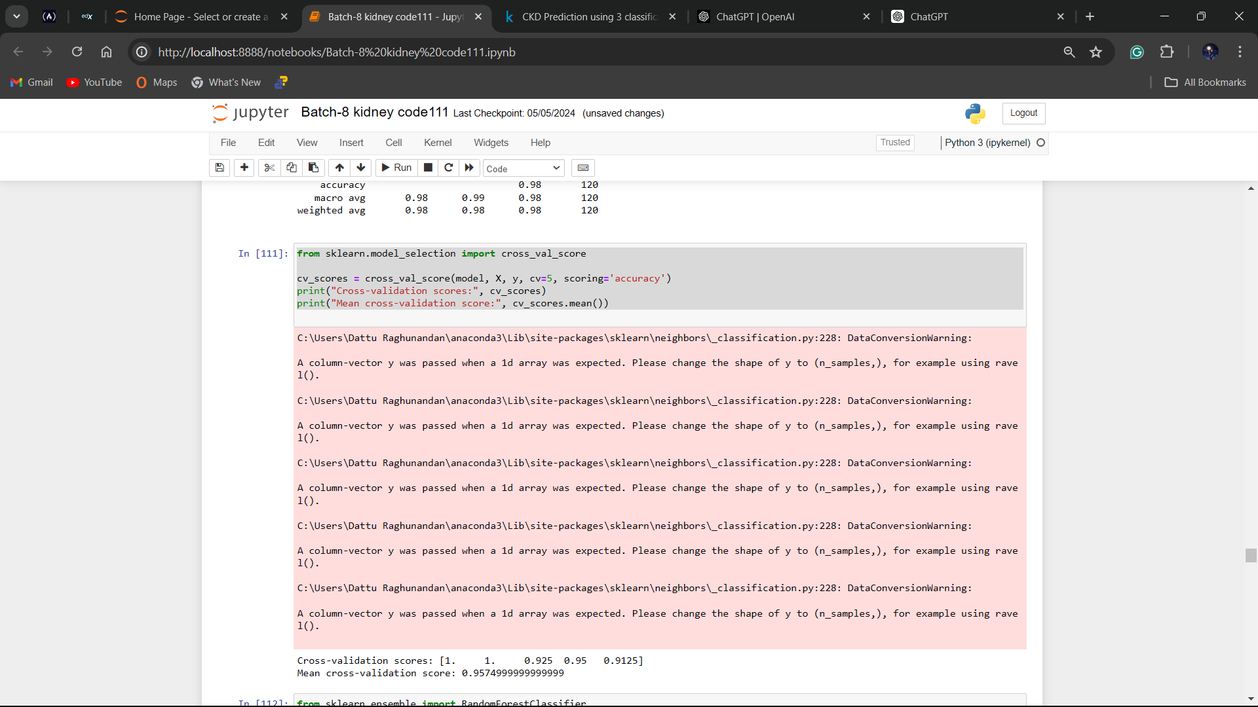
KNN Model:
Cross Validation:

Slide 10
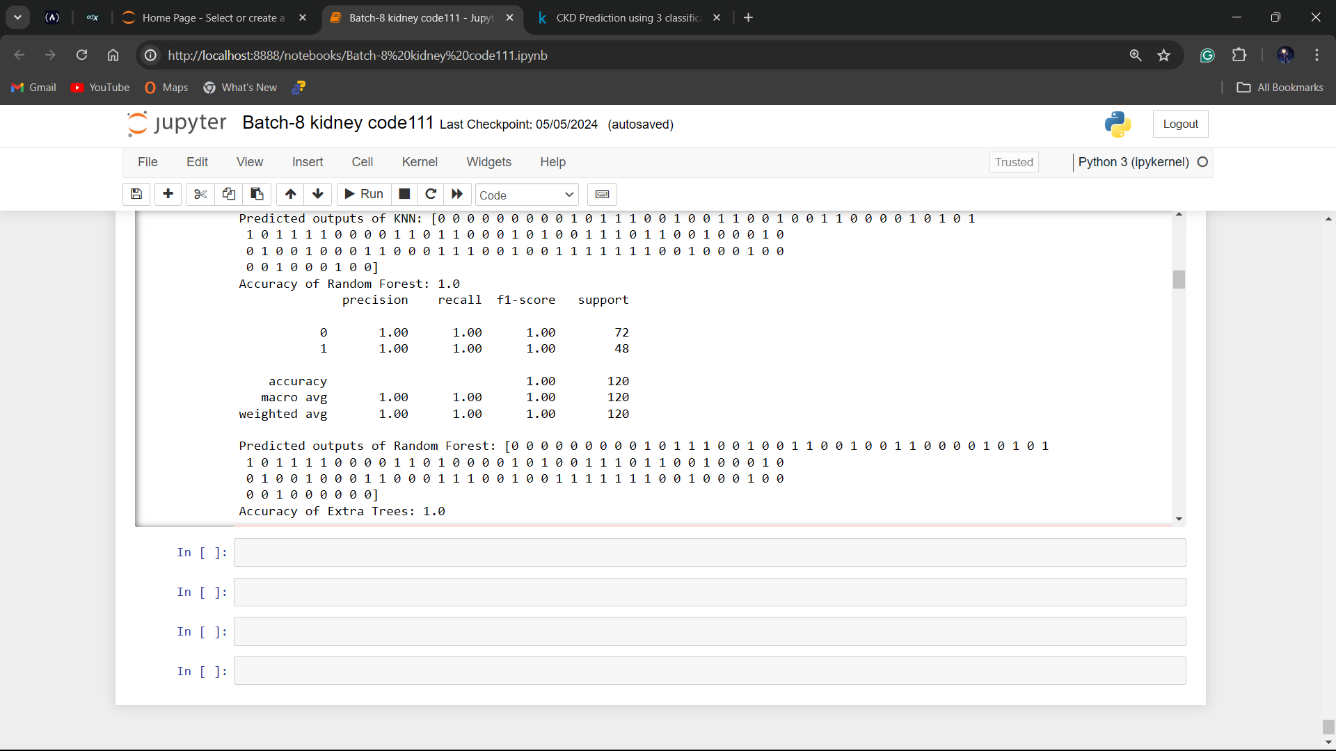
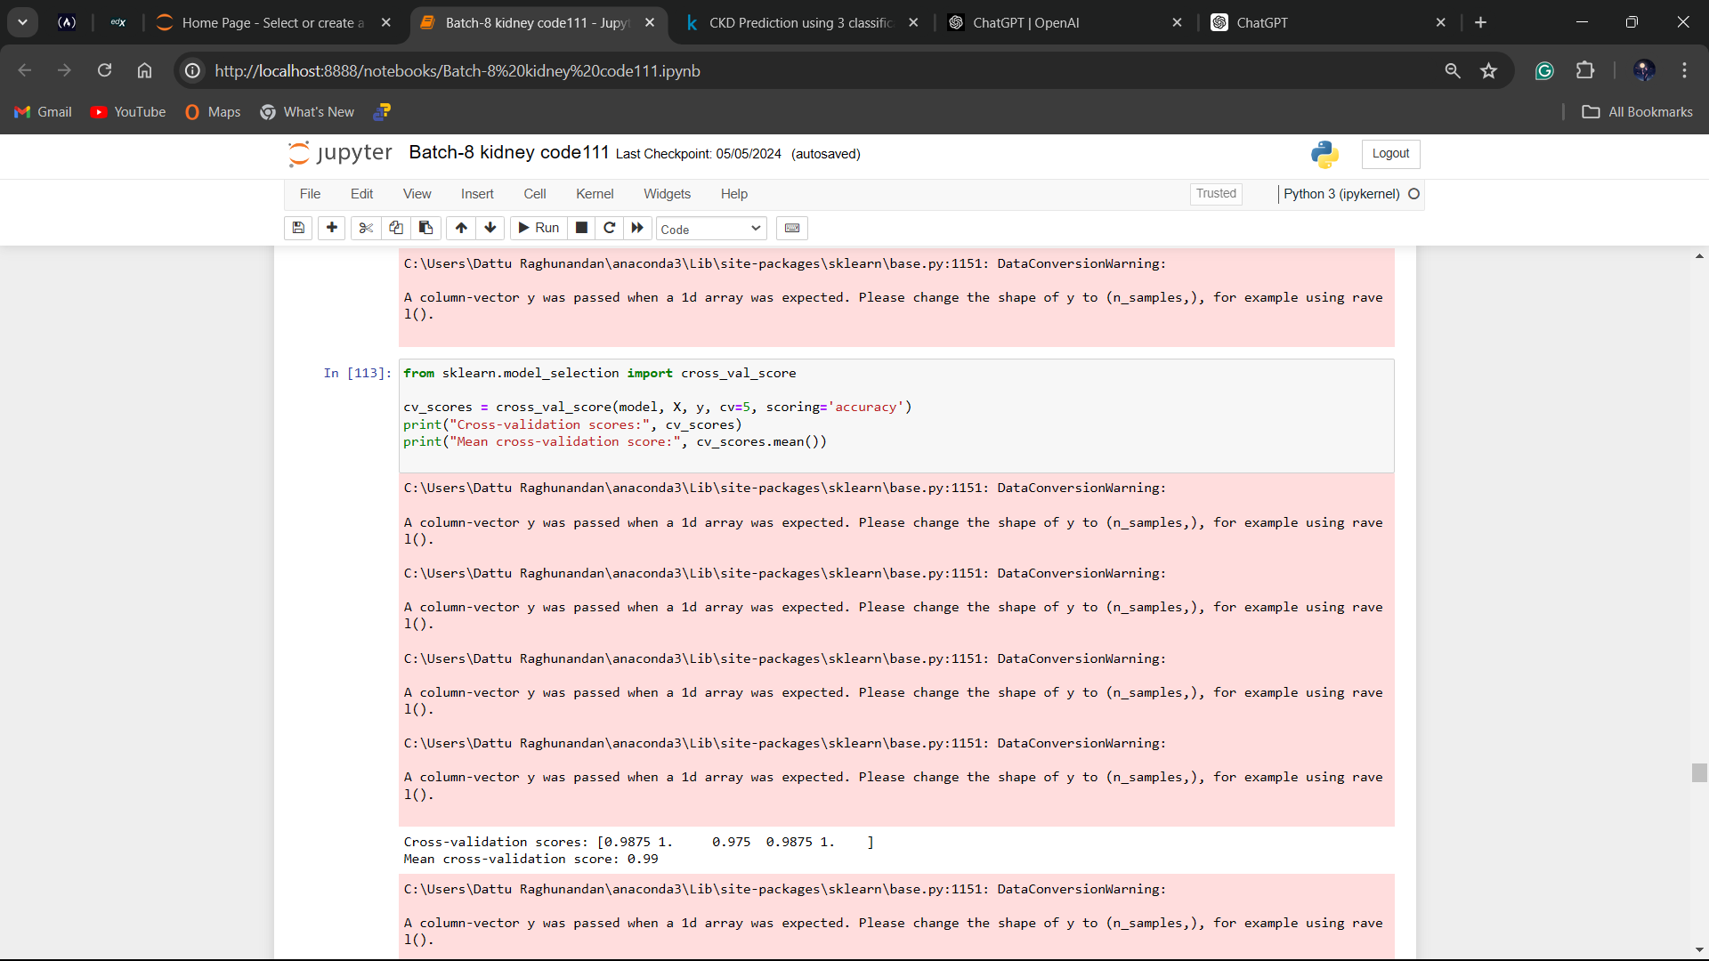
Random Forest Model:
Cross Validation:

Slide 11
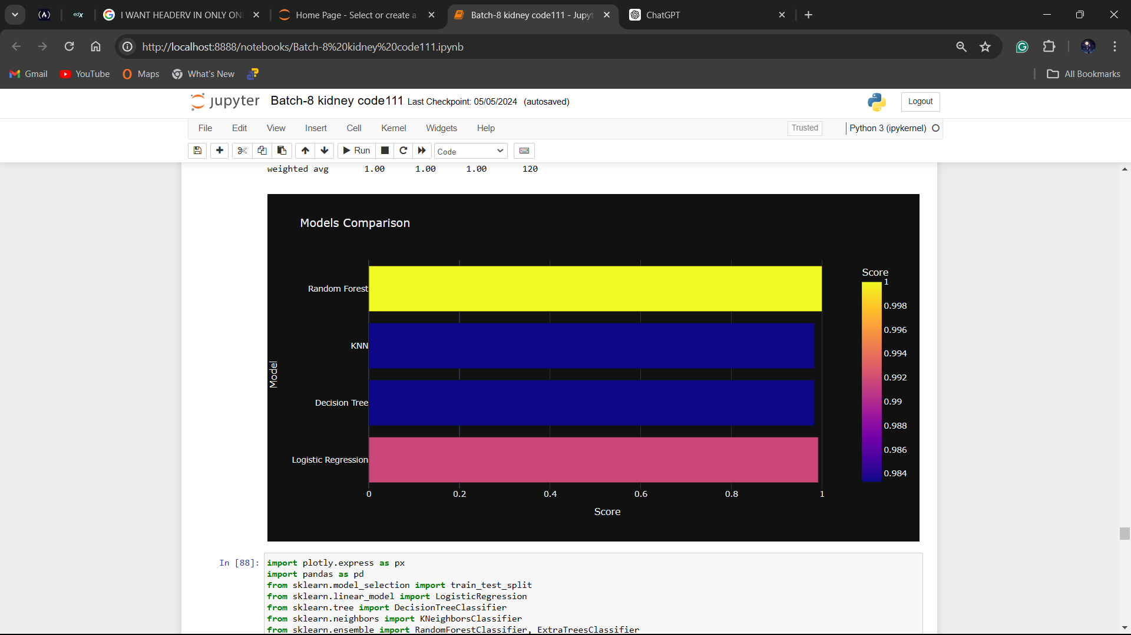
Model Comparison
Accuracies:-
Logistic Regression=99%
Decision Tree Classifier=98%
KNN=99%
Random Forest=99

Slide 12
CONCLUSION
In Conclusion, Tackling Chronic Kidney Disease (CKD) is vital due to its global impact on health, with a significant increase in cases affecting a substantial portion of the population. Early detection is paramount, offering the opportunity for effective treatment and control. This project's aim to develop a straightforward predictive model using accessible parameters underscores a commitment to making a meaningful contribution to healthcare. By identifying key factors influencing CKD risk through approaches like logistic regression, decision tree classifier, and k-nearest neighbors, we hope to provide healthcare professionals with valuable insights. Ultimately, this comprehensive strategy empowers timely interventions, offering a promising avenue to enhance patient outcomes and address the critical challenge of CKD early detection on a broader scale.

Slide 13
PREFERENCES
Software and Packages:-
Scikit-learn Documentation. Available at: https://scikit-learn.org/stable/documentation.html
NumPy Documentation. Available at: https://numpy.org/doc/
Pandas Documentation. Available at: https://pandas.pydata.org/docs/
Matplotlib Documentation. Available at: https://matplotlib.org/stable/contents.html
Seaborn Documentation. Available at: https://seaborn.pydata.org/tutorial.html
Missingno Documentation. Available at: https://github.com/ResidentMario/missingno
KNeighborsClassifier Documentation. Available at: https://scikit-learn.org/stable/modules/generated/sklearn.neighbors.KNeighborsClassifier.html
LogisticRegression Documentation. Available at: https://scikit-learn.org/stable/modules/generated/sklearn.linear_model.LogisticRegression.html
DecisionTreeClassifier Documentation. Available at: https://scikit-learn.org/stable/modules/generated/sklearn.tree.DecisionTreeClassifier.html
Dataset taken from https://www.kaggle.com/datasets/mansoordaku/ckdisease

Slide 14
THANK YOU

